Slide 1
AI and Machine Learning
12211810 潘炜

Slide 2
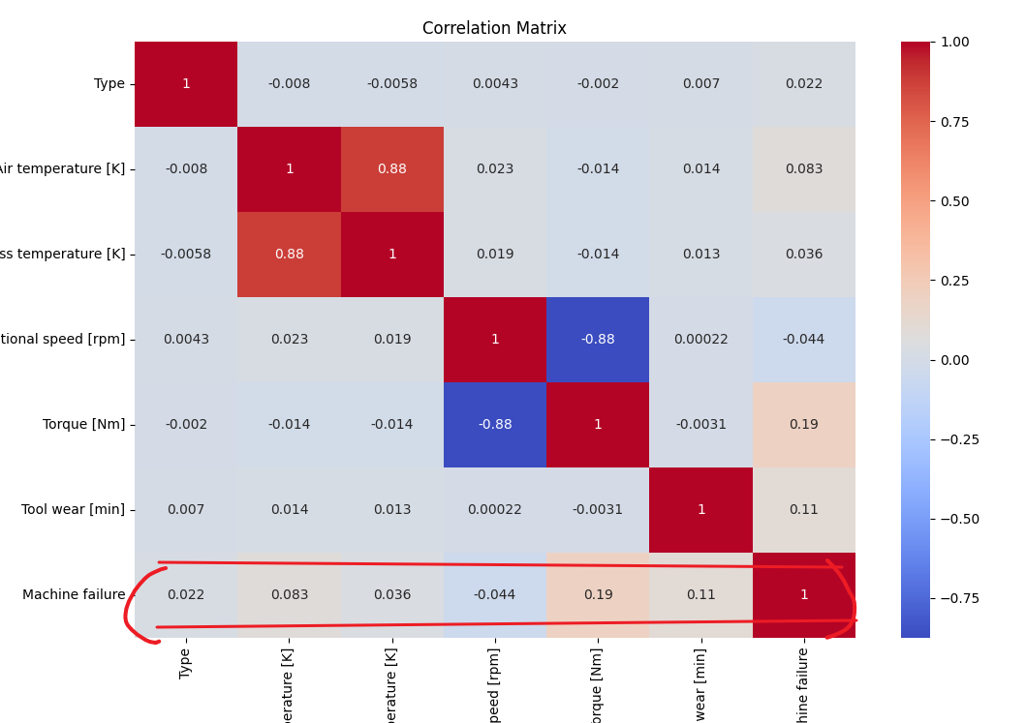
Feature engineering
12211810 潘炜

Slide 3
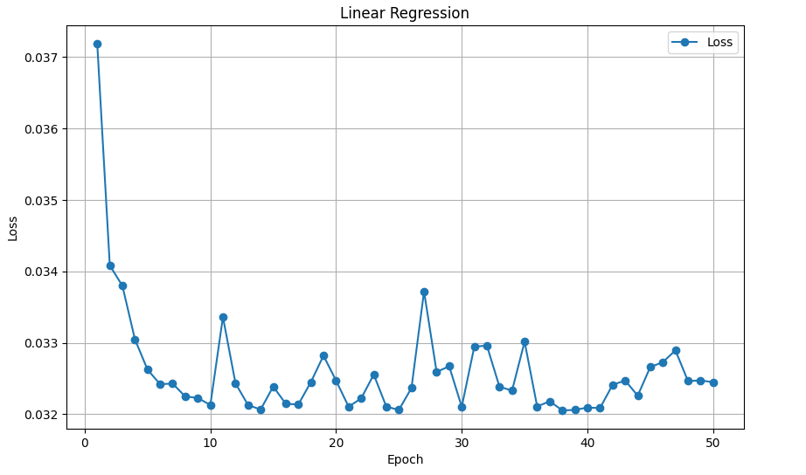
linear regression
-

Slide 4
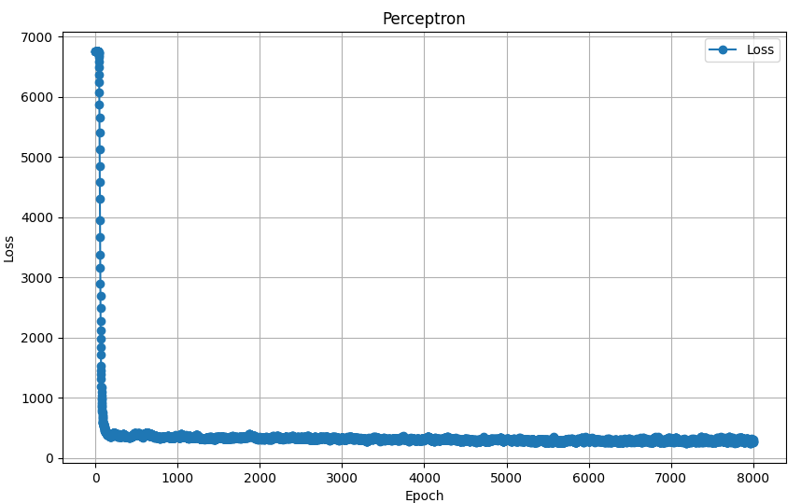
perceptron

Slide 5
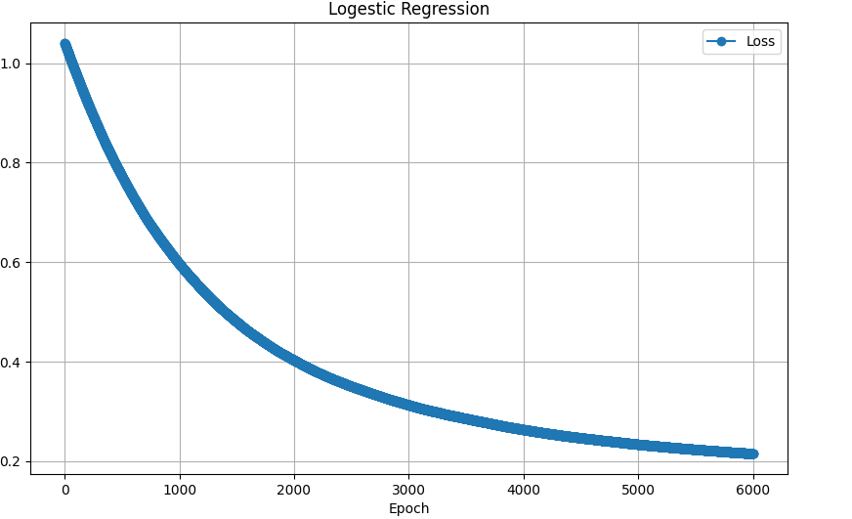
Logestic regression

Slide 6
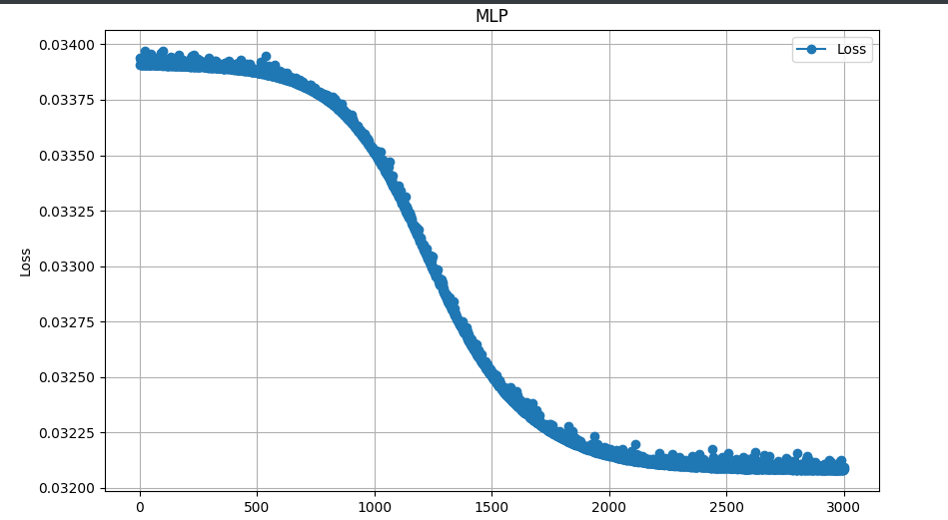
MLP

Slide 7
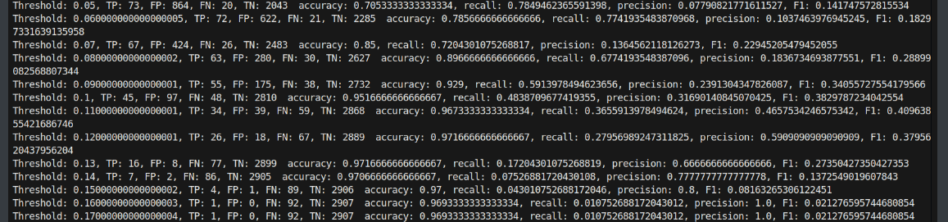
MLP

